Slide 1
Hubspot and Motion AI :
Chatbot-Enabled CRM

Slide 2
Group members
Group-9
Md Saif 200577
Pooja meena 200687
Pulkit tiwari 200739
Raju kumar 200765
Anuj kumar 200164
Goudesh kadakol 200391
Fenil patel 200676

Slide 3
Introduction:-
What is hubspot?
What is Motion AI ?
What is chatbot?
Entire Motion AI team joined Hubspot

Slide 4
Advantages
Provided opportunity for CRM
re-engage users that had gone dormant by suggesting new ways to interact
Provided instant response
chatbots completed customer interactions at twice the speed and a fraction of the cost as human provided telephone support..
Provide a less time consuming solution
simpler one than digging through a whole website of content.
without any hassle of downloading another app.

Slide 5
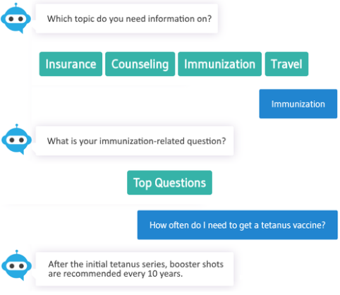
Reduced the amount of typing
By derive their desired information.
For acquiring customer information.
applies more to chatbots used for marketing or sales purposes.
Chatbots can be used to sign visitors up for marketing newsletters, webinars etc.
Stranger attracted by inbound marketing content
With proper website tracking, businesses are also able to run ads to these pre-qualified audiences of people that have already visited their website

Slide 6
Challenges
andle complicated queries
Lack of Personalized Support
Unable to handle complicated queries
Prone to misunderstanding conversation
Fear of Privacy Breach
Prone to misunderstanding conversation

Slide 7
Lack of Personalized Support
Lack of feelings
Emotionally unavailable
Unable to handle complicated queries
“According to a study by Facebook, chatbots fail to serve customer needs 70% of the time”
Negative customer feedback
Careful maintenance

Slide 8
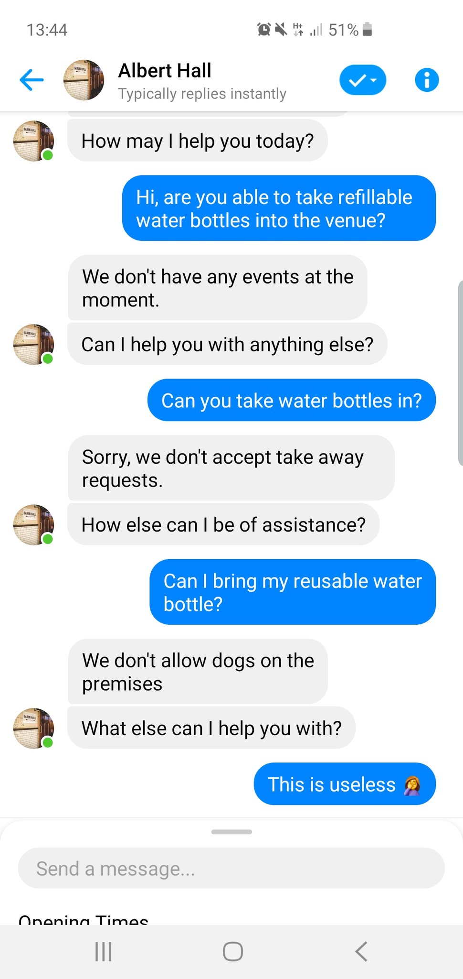
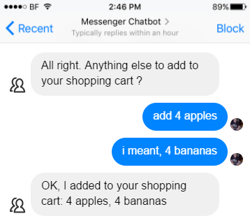
Prone to misunderstanding conversation
Language is hard to model
Customer get frustrated

Slide 9
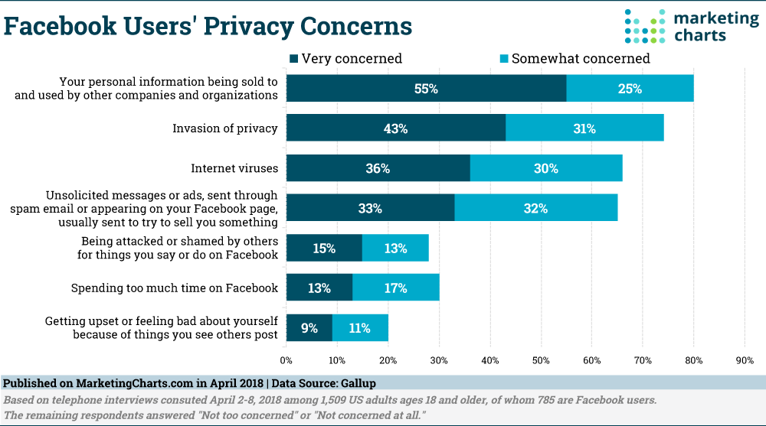
Fear of Privacy Breach
‘Internet privacy is a fiction’

Slide 10
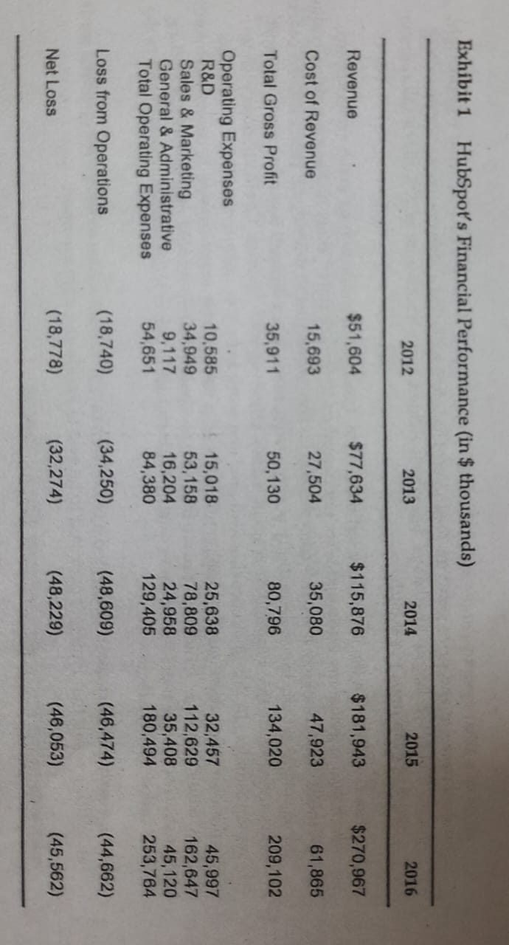
The Market for Chatbots
According to McKinsey & company technology companies spent $20-30 billion on AI in 2016.

Slide 11
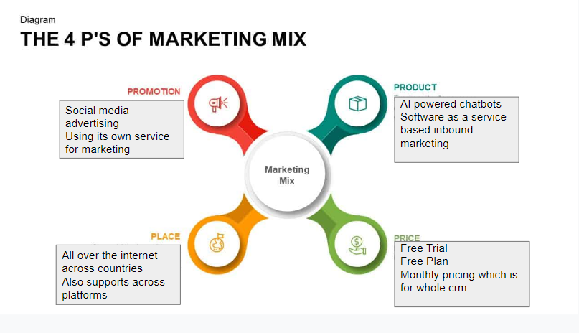
Marketing mixes(4Ps)(PULKIT)

Slide 12
Sales Funnel
•Top-funnel: increases brand awareness and trust.
•Middle-funnel: supports buyer research and evaluation.
•Bottom-funnel: validates buyer decision and purchase.

Slide 13
Human Vs Machine?
What would be the consequences on brand loyalty ?

Slide 14
Implementation of solution and recommendation
Switching with live customer care
Collection of Data: CRM system-conversations feature
Bot like Bot or Human like Bot

Slide 15
THANK YOU

